Slide 1
Contemporary Tourism
Supporting the Contemporary Tourism Product - Service Management

Slide 2
Lecture Objectives
Appreciate the relationships between the elements of the destination product and experience
Understand a ‘service management’ perspective
Recognise the difference between ‘product’ and ‘customer’ orientations
Be aware of issues related to tourist satisfaction
Be familiar with the concept of, and challenges with, managing and measuring service quality
Understand the frameworks which link employees, customers and organisational performance
View human resource management as a strategic function

Slide 3
Context
How do tourists evaluate tourism experiences?
Dependent on component parts
Evolution towards a ‘service mindset’
Tourism purchases are mainly services
Services lead to a strategic view
This is a relatively new paradigm for tourism

Slide 4
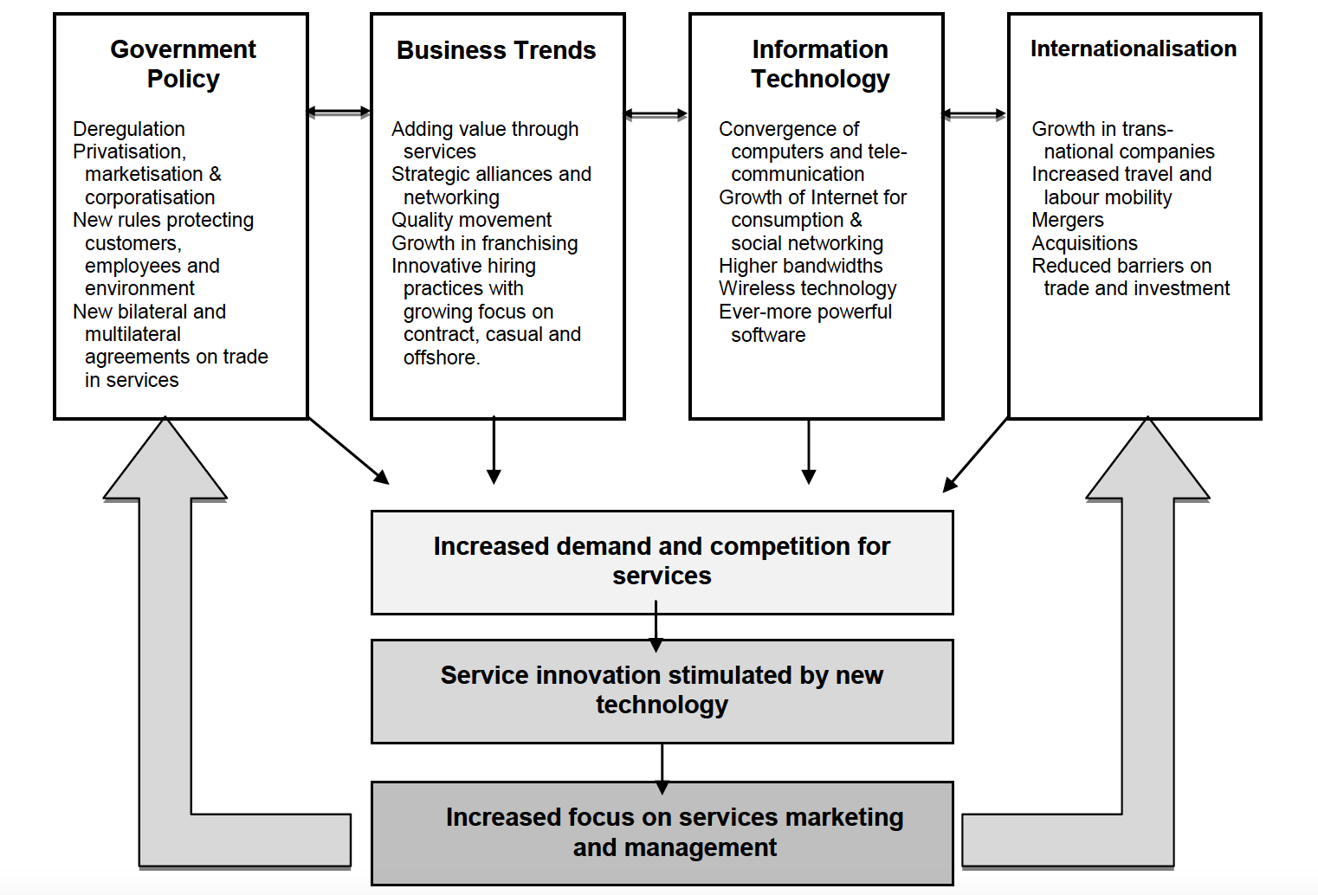
Contributing factors to the transformation of the service economy

Slide 5
Definition
The central tenet of the service management paradigm was defined by Albrecht (1988):
“a total organizational approach that makes quality of service, as perceived by the customer, the number one driving force for the operations of the business” (p. 20).

Slide 6
Customer and Service Orientation
Customer at the centre of decisions
Customer centric focus
Not selling but creating value

Slide 7
Service Management Concepts
Service encounter
Customer contact employees
Customer satisfaction
More than satisfaction
Service quality
  SERVQUAL (although approach is strongly criticised it is still widely used)
  The Nordic model

Slide 8
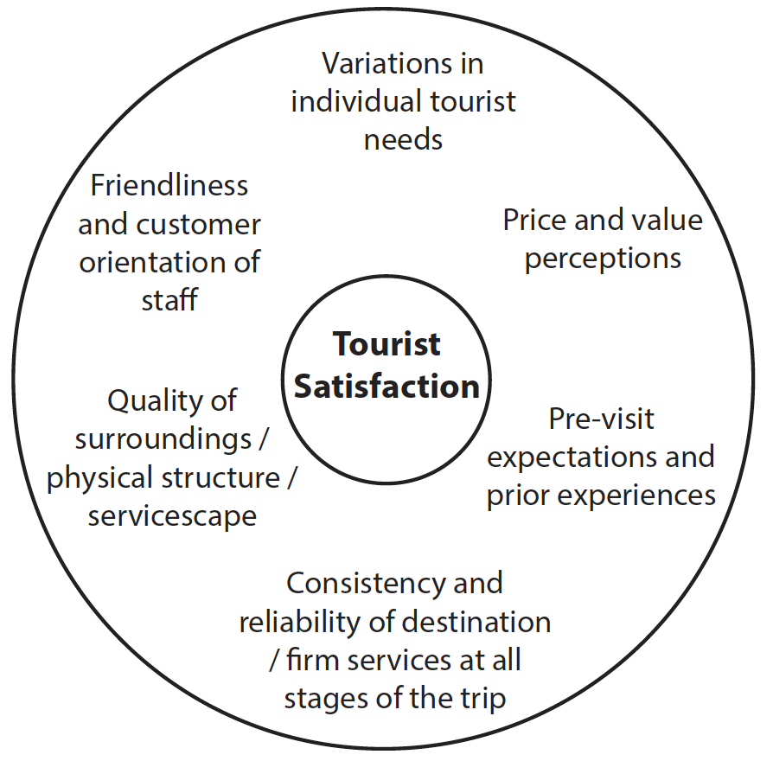
Factors that influence tourist satisfaction

Slide 9
Tourists, Employees and Business Performance
Service profit chain
Employee-customer linkage research

Slide 10
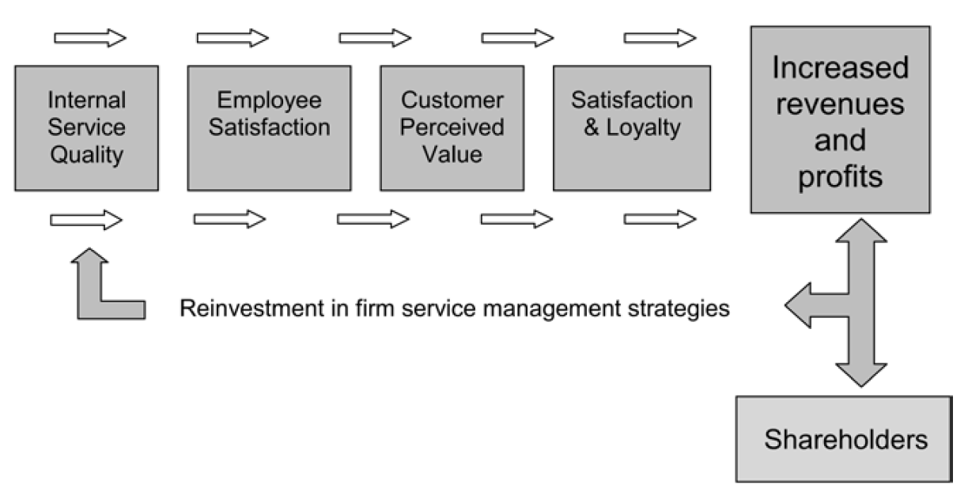
The service-profit chain

Slide 11
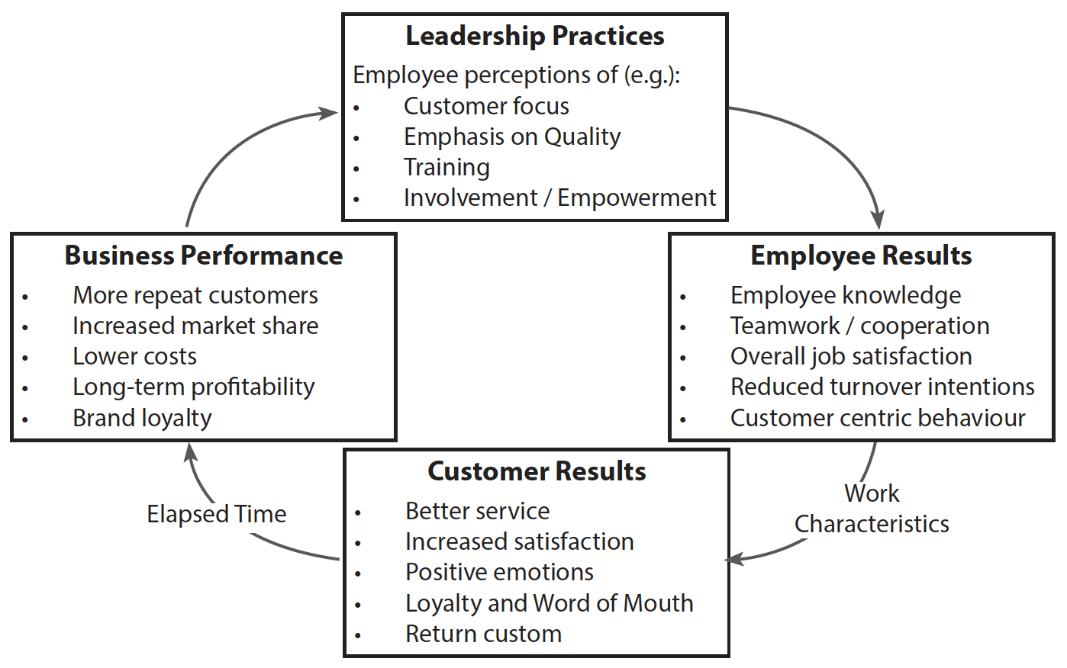
Employee-customer linkage model

Slide 12
Strategic HRM
HR are the tangible resources of the firm
From personnel management to SHRM
Integrates HR into strategy
Integral to the quality of the service encounter

Slide 13
Service Culture & Climate
All organizations have a culture
Manager cannot control all encounters
Creation of a service climate
Balanced scorecard approach

Slide 14
Balanced Scorecard elements
How do customers see us?
What must we be good at in order to satisfy our customers (internal processes)?
How can we continue to improve and grow (learning and training)?
How do we look to our owners / shareholders (financial picture)?

